Slide 1

DATA SCIENCE INTERNSHP PROJECTS
Project 16 : HR Absenteeism Data analysis
Project 13 : Google Playstore App Data analysis
Submitted by : Devendra Krishnakalva
CRIN ID : CRIN22124997

Slide 2
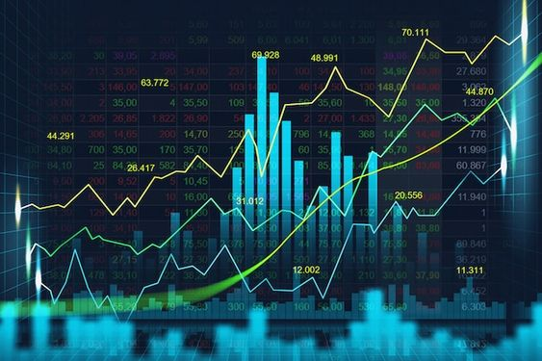
1.HR ABSENTEEISM Data
Analysis and Visualization
- By Devendra Krishnakalva

Slide 3
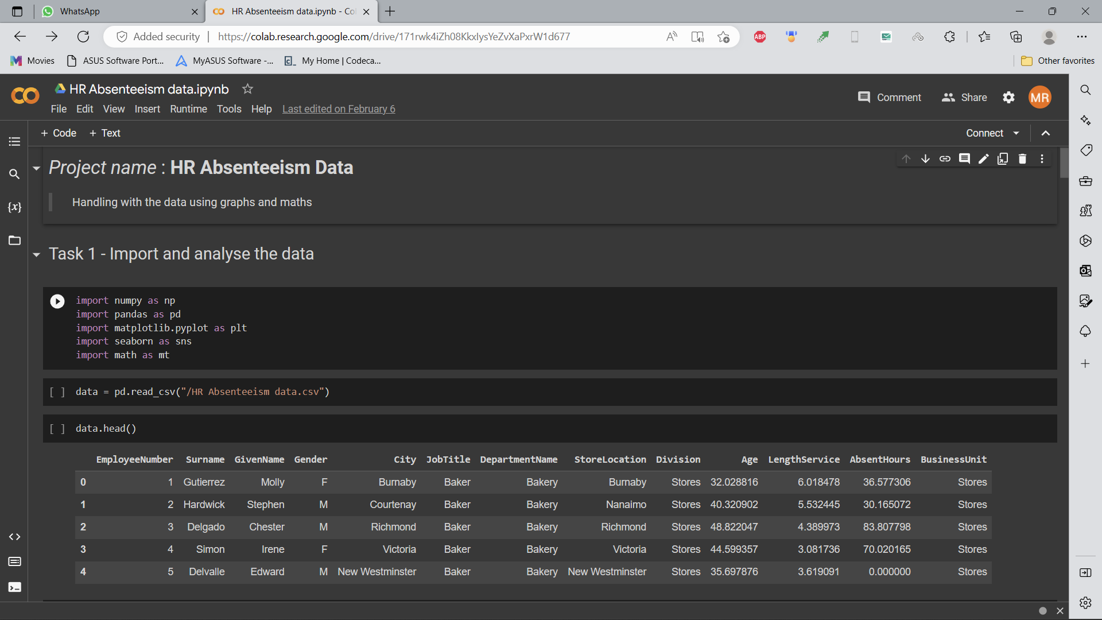
Task 1 - Load the data and analyzing the Data
First of all download the data.
Import all the required Libraries.
Load the data using pandas.

Slide 4
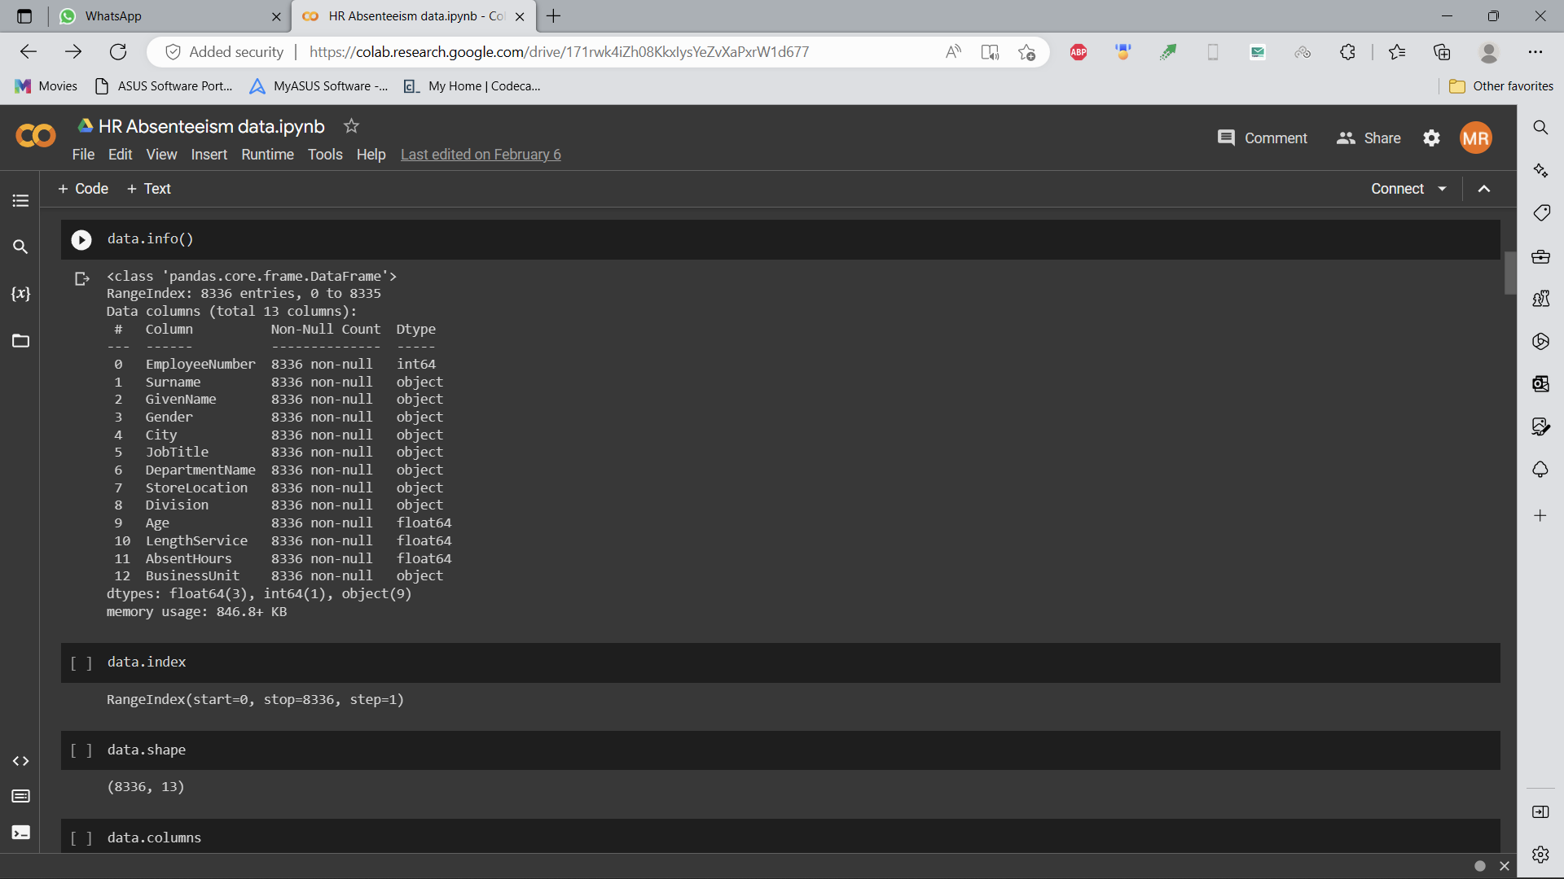
Getting basic information about the data.
Use methods like “ .info() .shape() .columns() ” to get details.

Slide 5
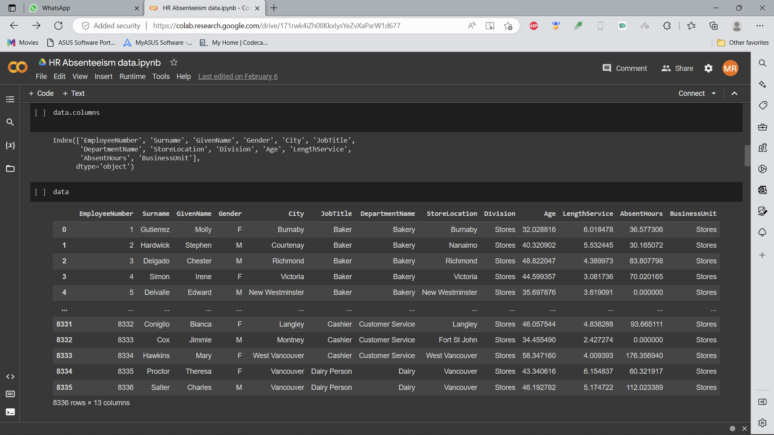
Using the above commands gives us the basic information about our data.
Such as columns, no. of rows and columns, amount of data…,etc.

Slide 6
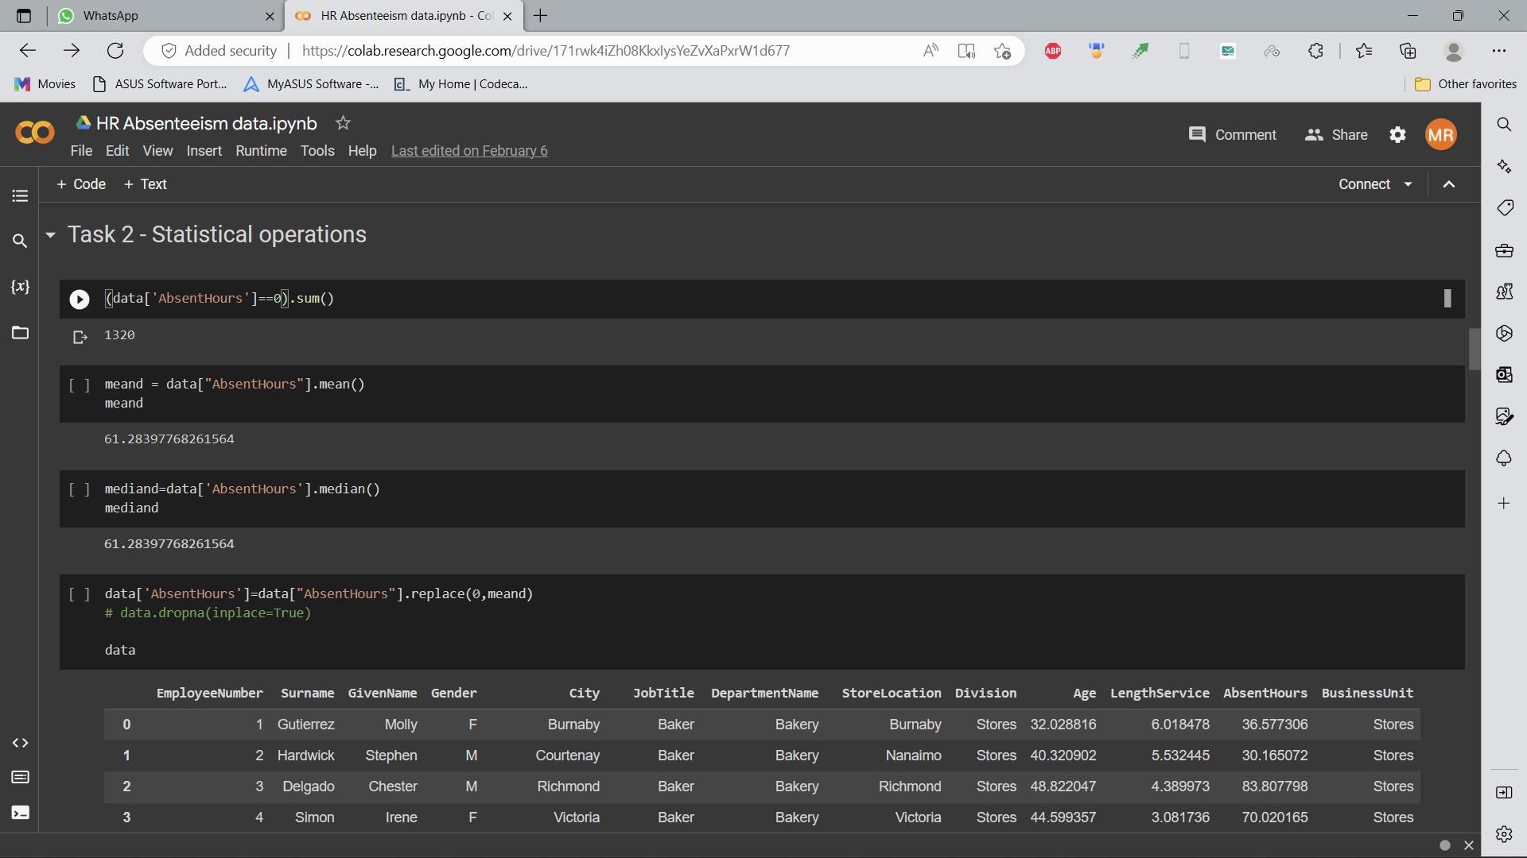
Task 2 - Statistical Operations Visualization
Statistical operations are required to
Find missing values
Replace the null values

Slide 7
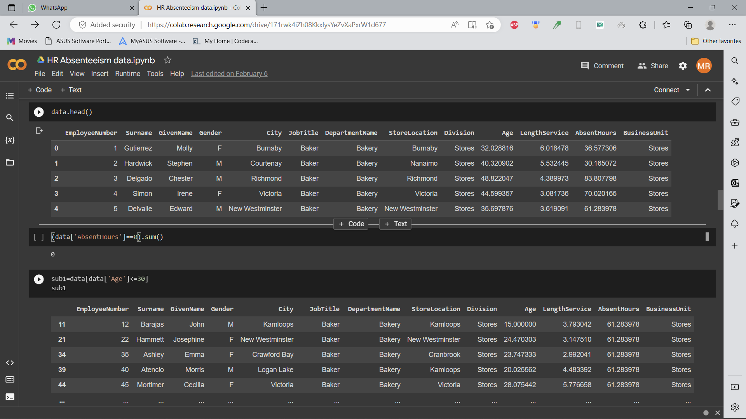
Finding the NULL values in the data.
Find Median and Mean.
And replace the NULL values with mean.
Searching for the missing values in a particular column.

Slide 8
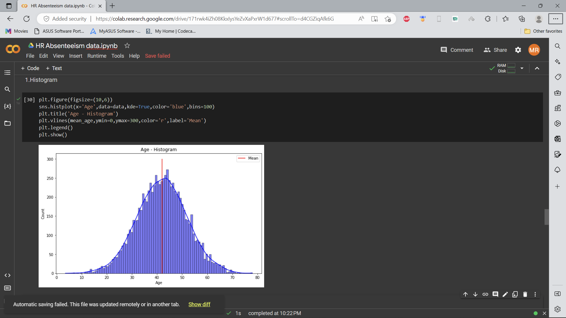
HISTOGRAM
Plotting the Histogram of the Data.
A Histogram is drawn to count the people according to Age.
The mean and median were also calculated and plotted.

Slide 9
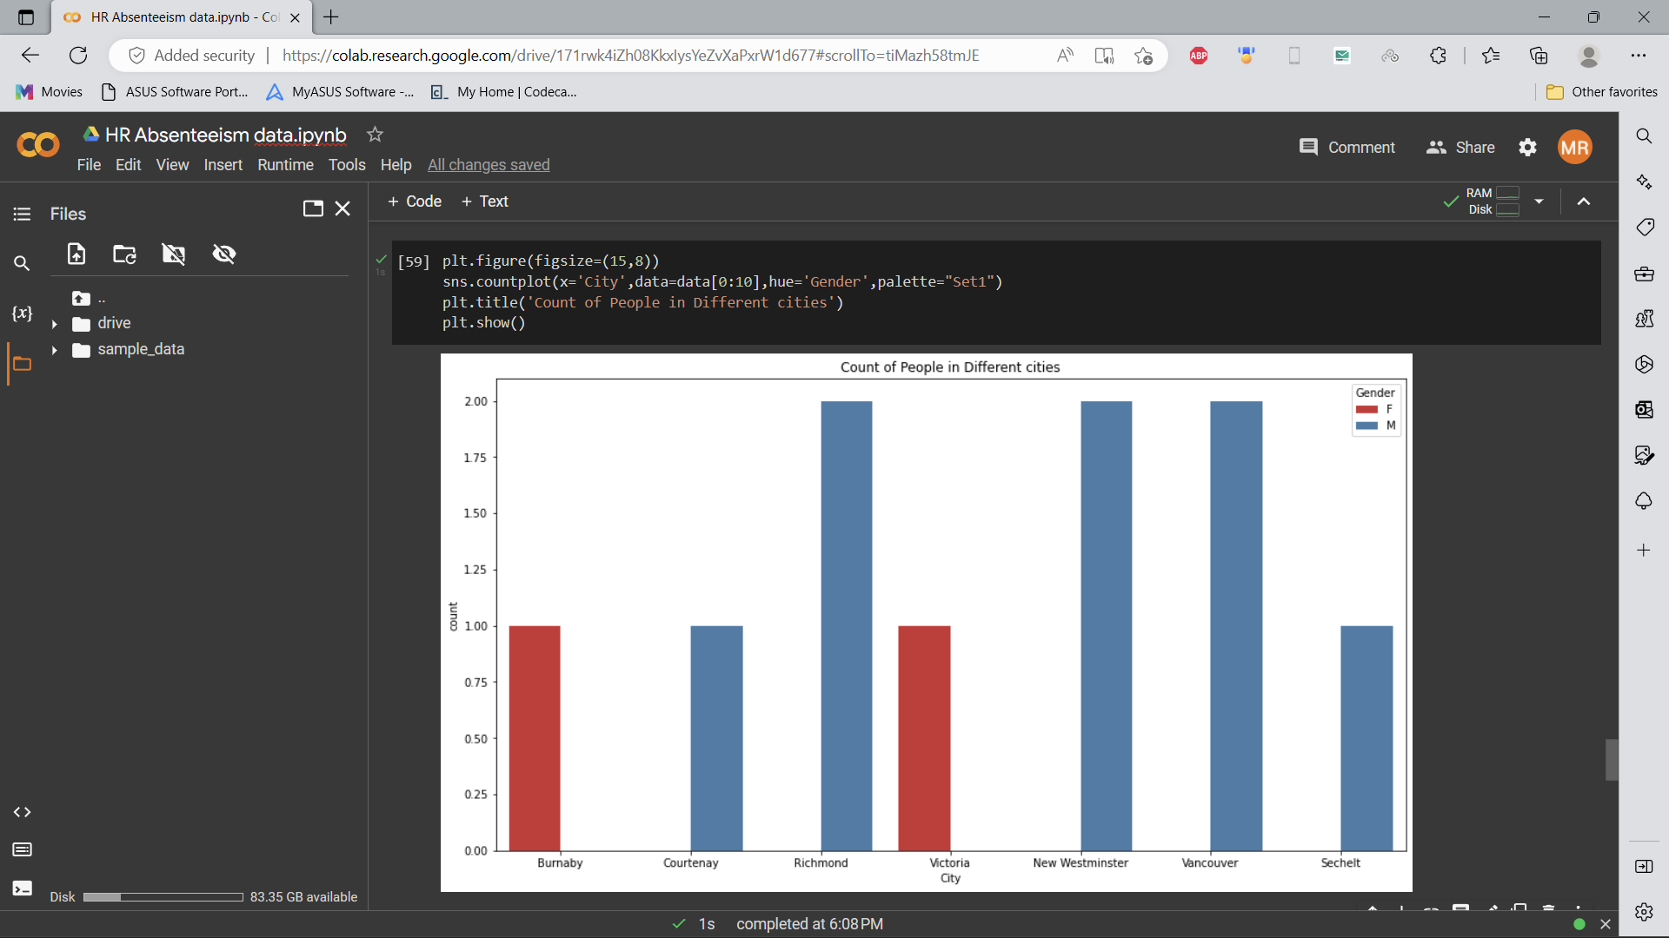
COUNTPLOT
Count plot is used to know the count from different regions.
It is separated for both Male and Female Employees.
Graph is limited for only 10 samples.

Slide 10
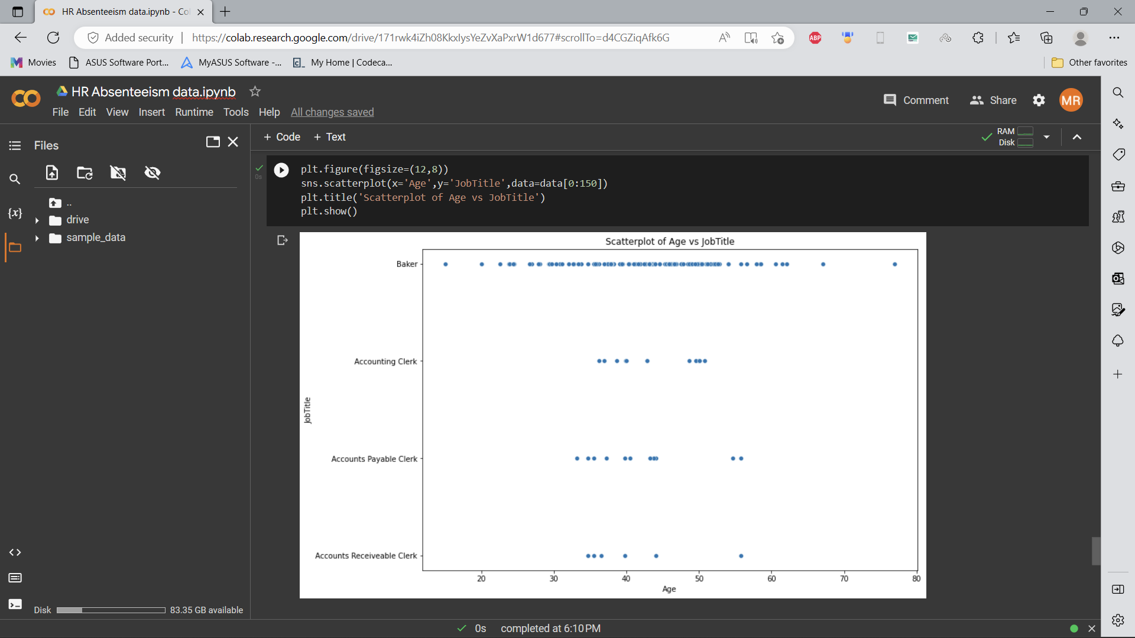
SCATTER PLOT
Scatter plot to know the spread the data depending on their JOB.
Upto the plotted data Baker job was hold by many people.
Accounts receivable clerk holds the least Number.

Slide 11
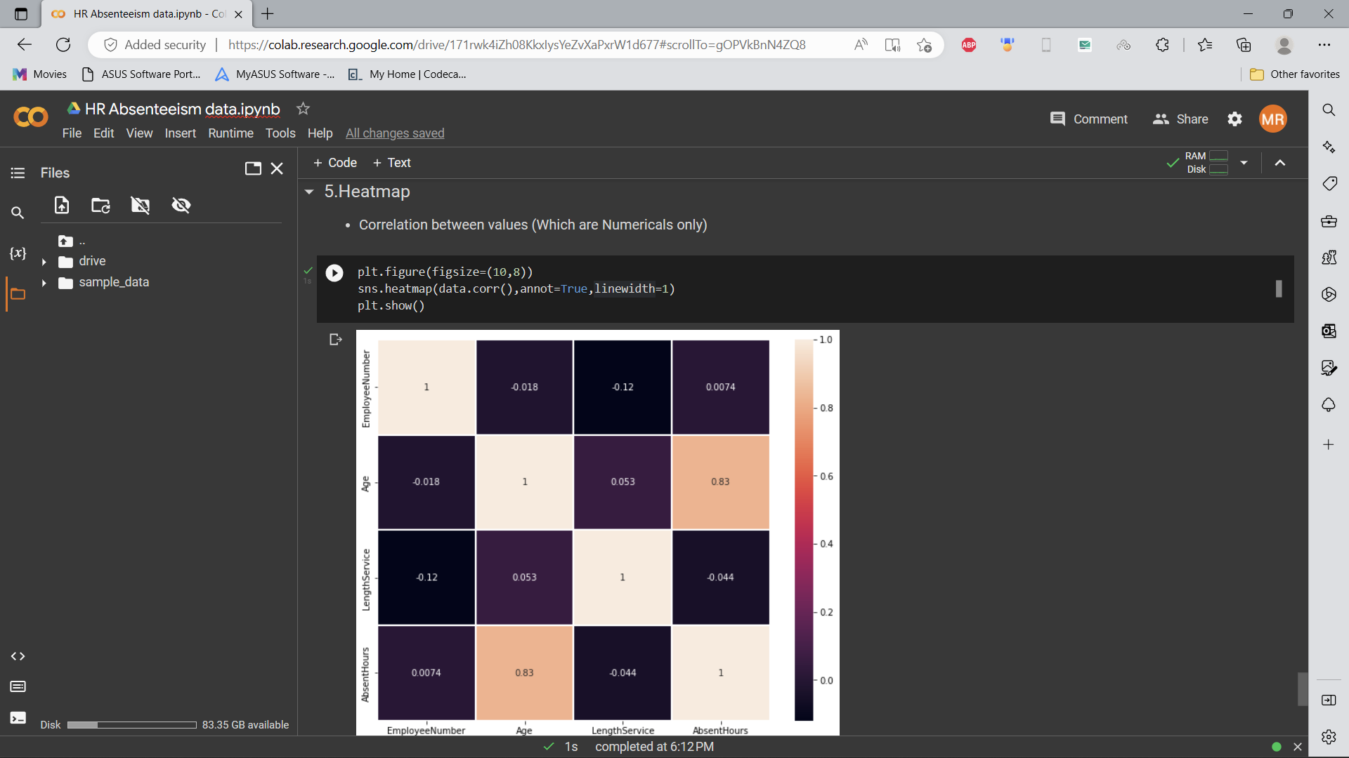
HEATMAP
Heatmap to find the relation between numerical columns.
Highest related columns are Age and Absent hours.
Employee number and Length of service are not related at all.

Slide 12
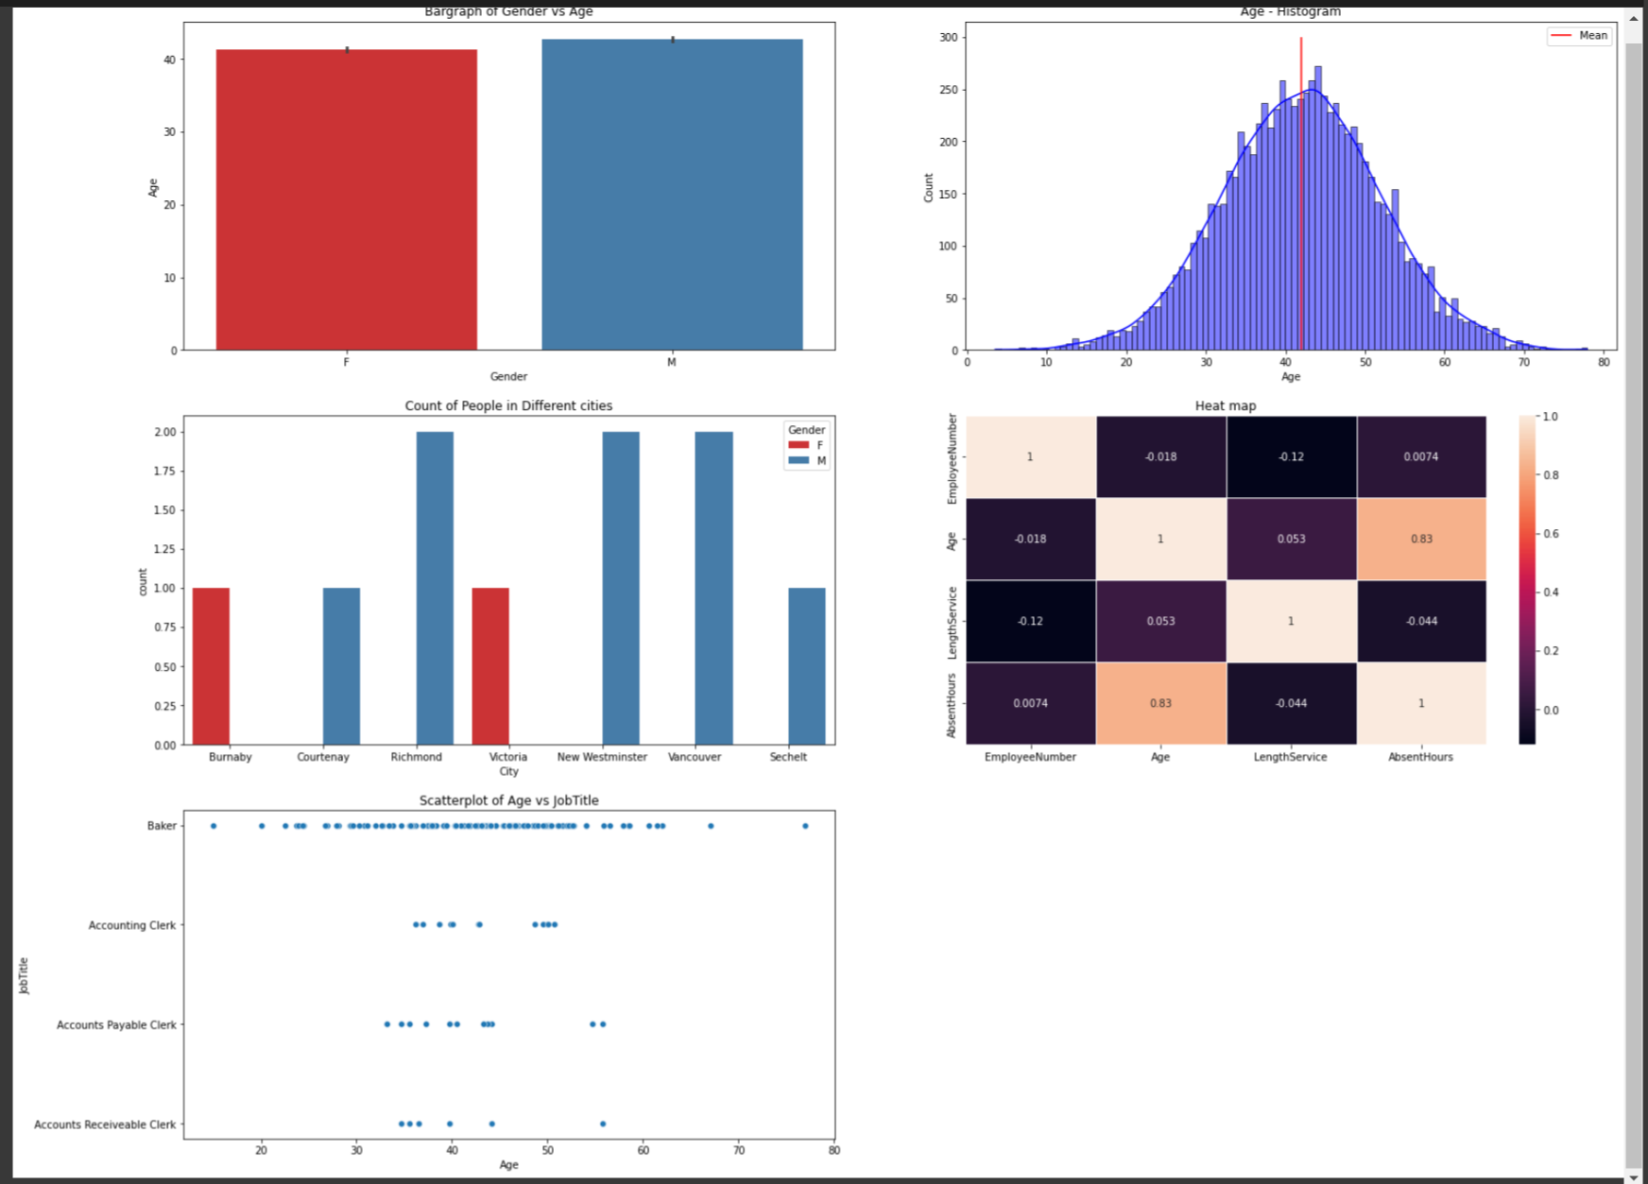
OVERALL PYTHON VISUALIZATION

Slide 13
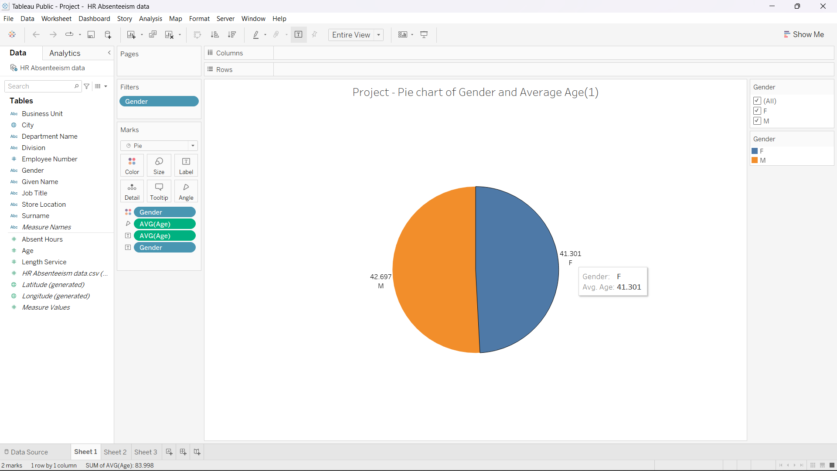
TABLEAU CHARTS - PIE CHART
Tableau has been used to draw the relations from all samples.
It can be used for large data plotting.
A pie chart has been plotted to know the average age of the working employees.

Slide 14
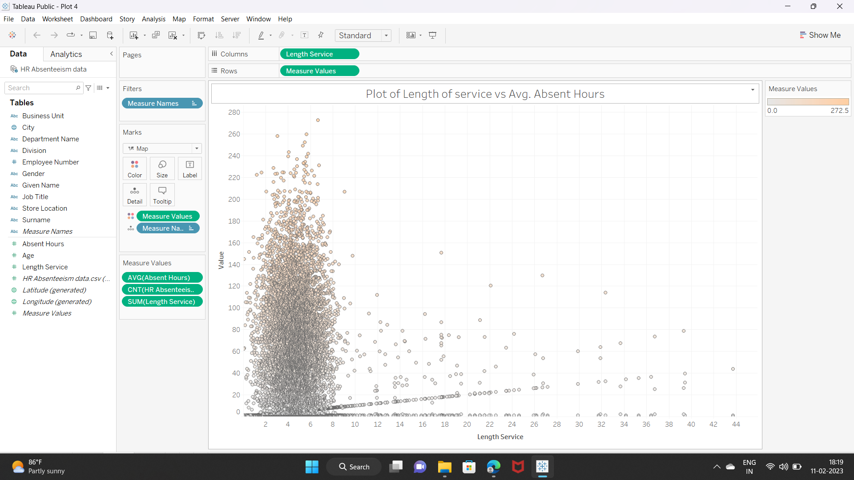
SCATTERPLOT
The length of service and Absent hours were the parameters.
The plot shows that the count is high for age range of experience of upto 8 years.

Slide 15
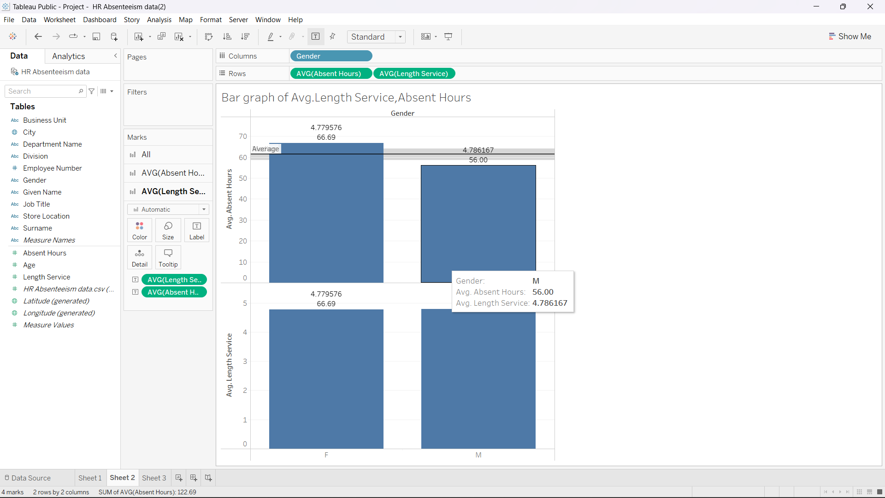
BARGRAPH
Graph shows the relation between gender and length of experience.
The average value in each case were highlighted.

Slide 16
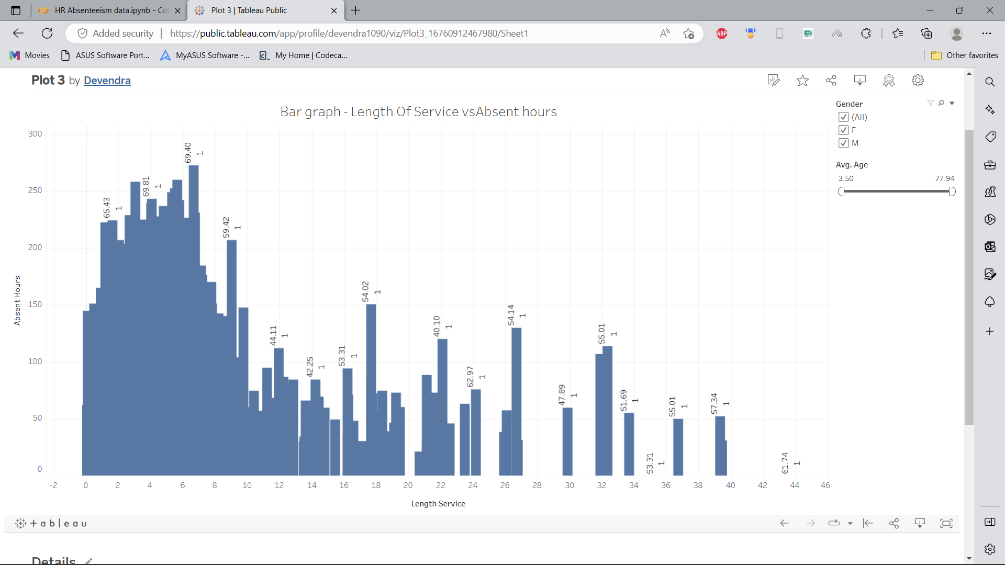
This plot shows the employee experience and their absent hours.
With increasing experience the absent hours has been decreased.

Slide 17
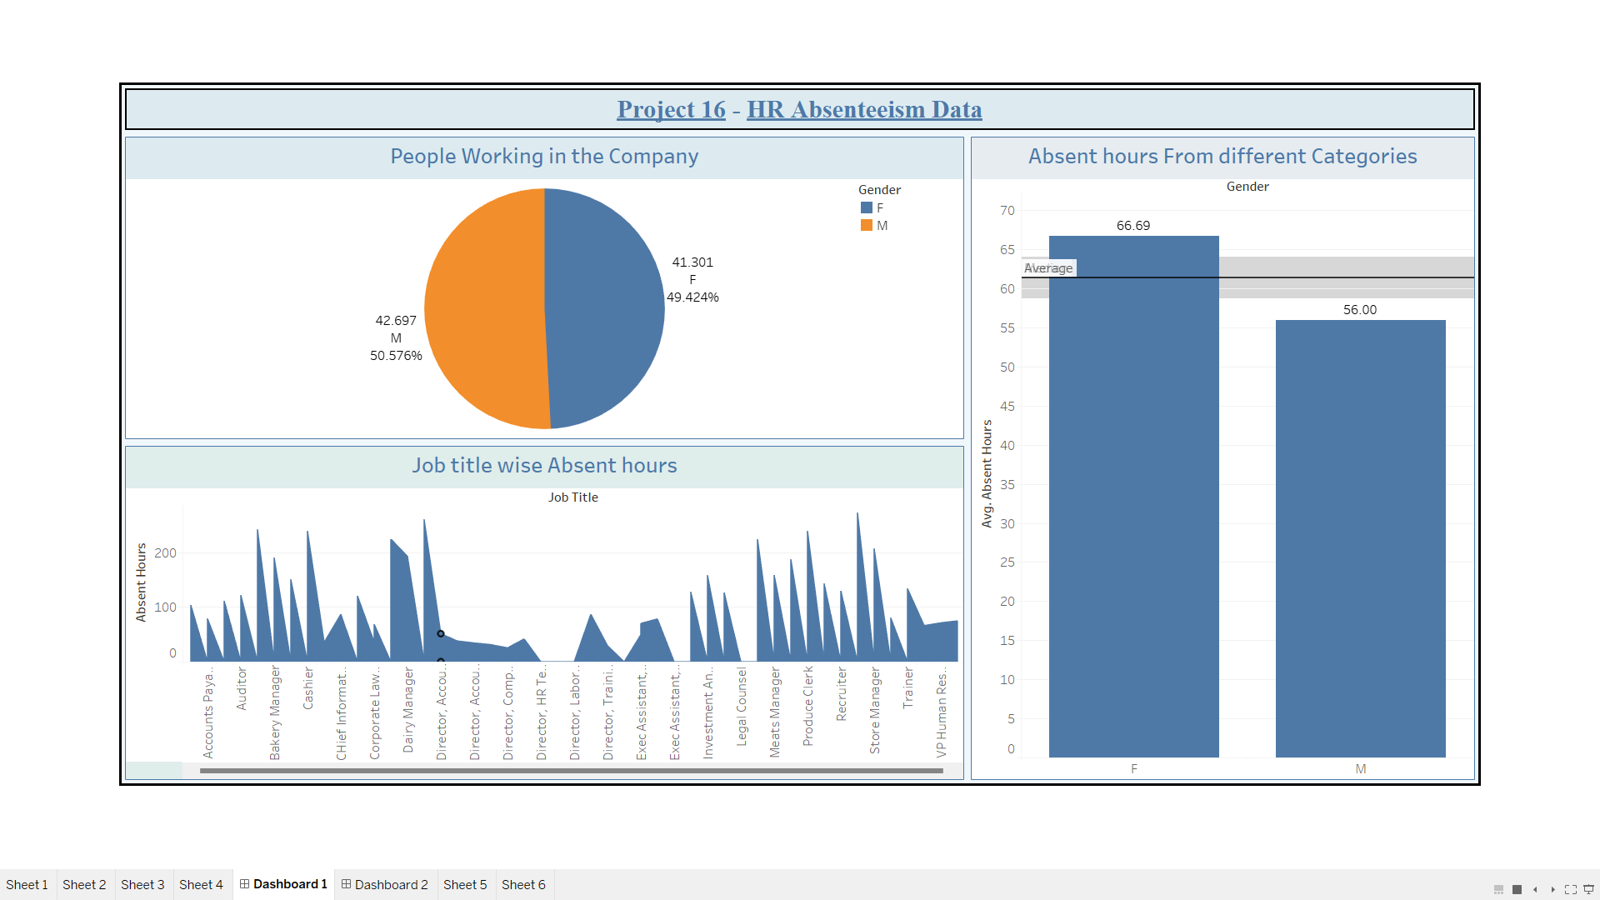
DASHBOARD 1

Slide 18
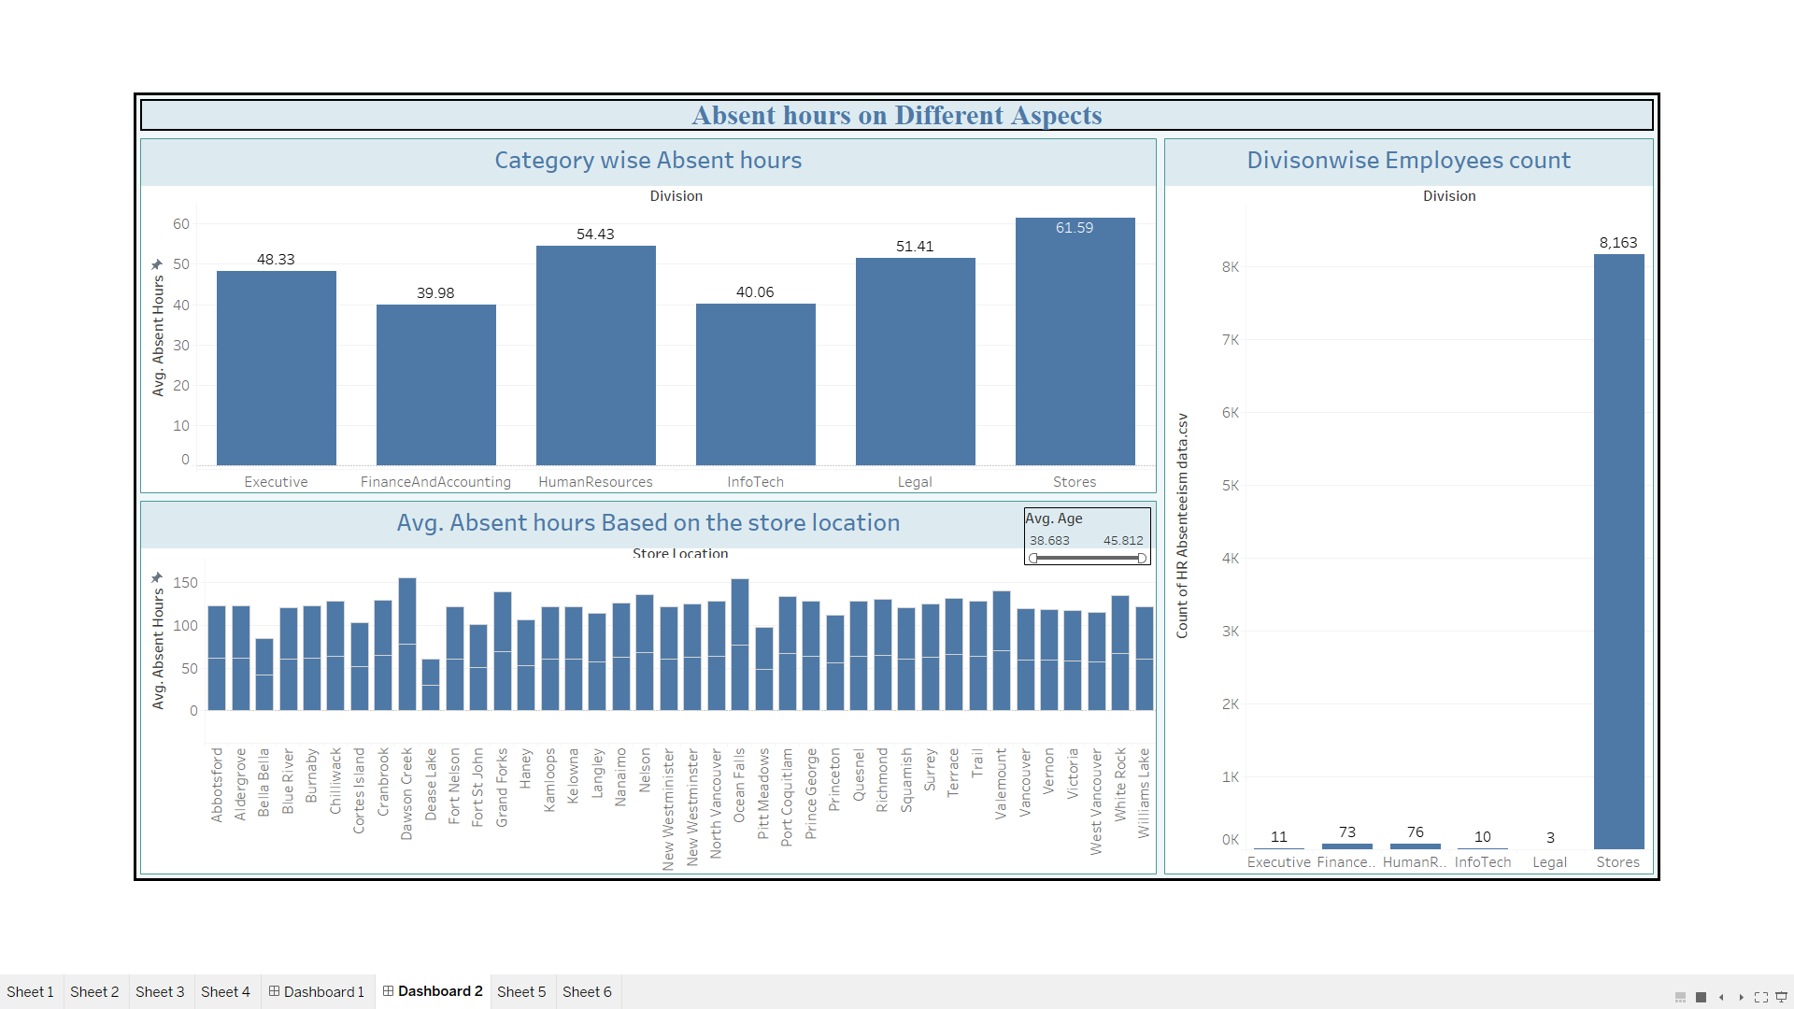
DASHBOARD 2

Slide 19
LINKS TO COLAB FILE AND TABLEAU DASHBOARD
Link to Google colab file :
https://colab.research.google.com/drive/1vW-65Ezf_N89JAm8_MOcLaPuwvW1TMc9?usp=sharing
Link to Tableau Dashboard :
https://public.tableau.com/views/Project-HRAbsenteeismdata/Dashboard2?:language=en-US&publish=yes&:display_count=n&:origin=viz_share_link

Slide 20

2.GOOGLE APP STORE DATA ANALYSIS
- By DEVENDRA KRISHNAKALVA

Slide 21
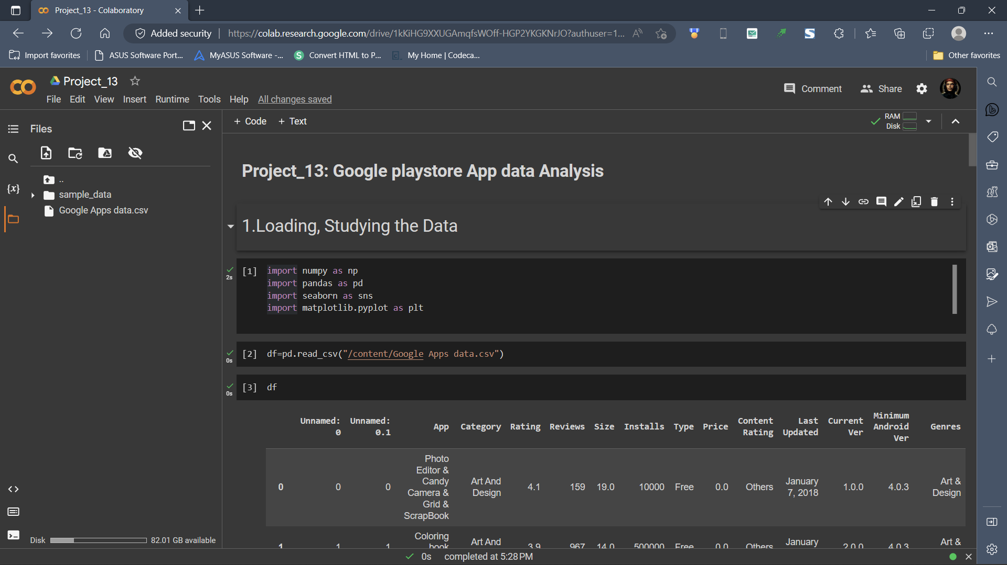
Task 1 : To load and analyse the data
Import the required libraries.
Load the data into Google colab file.

Slide 22
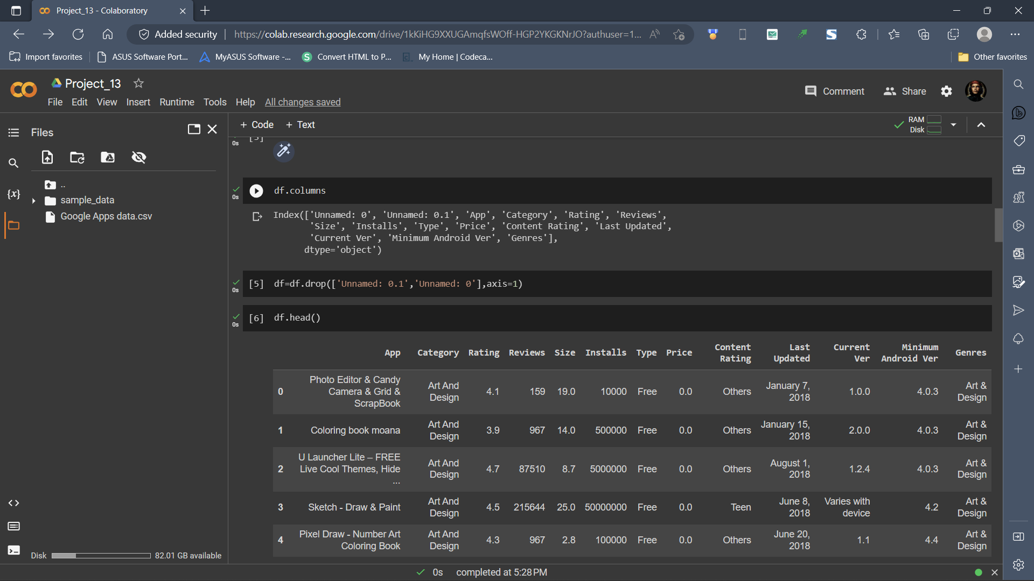
Task 2 :To perform statistical operations on Data
Analysis of the data(such as getting information about the data).
Finding the missing values.

Slide 23
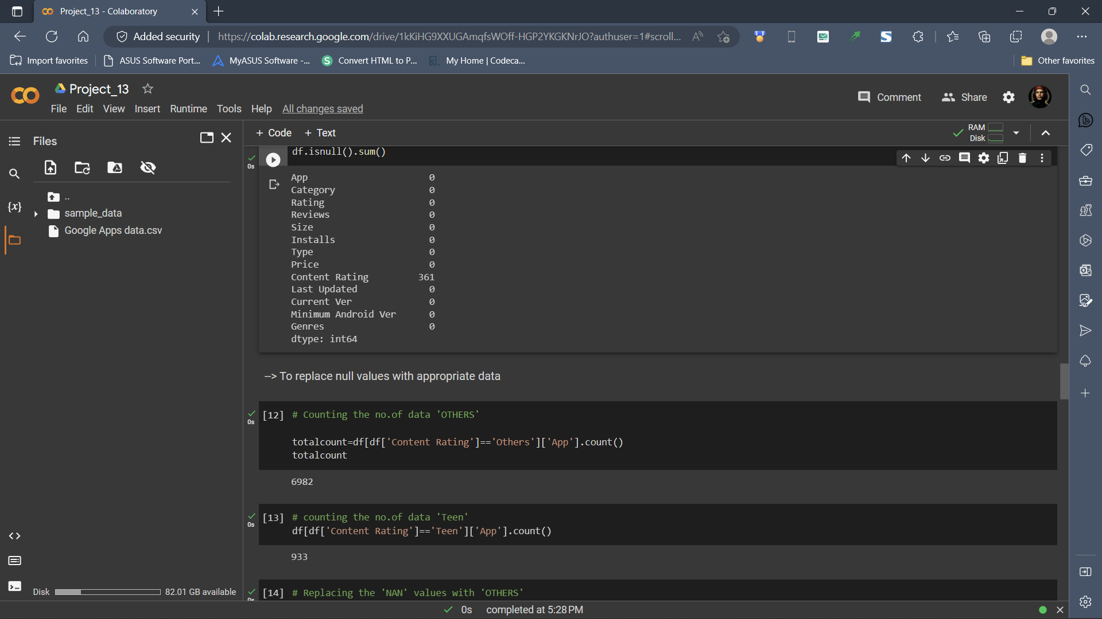
As there are 361 null values we should replace them with appropriate values.
When the data is analyased then we can get visualization.

Slide 24
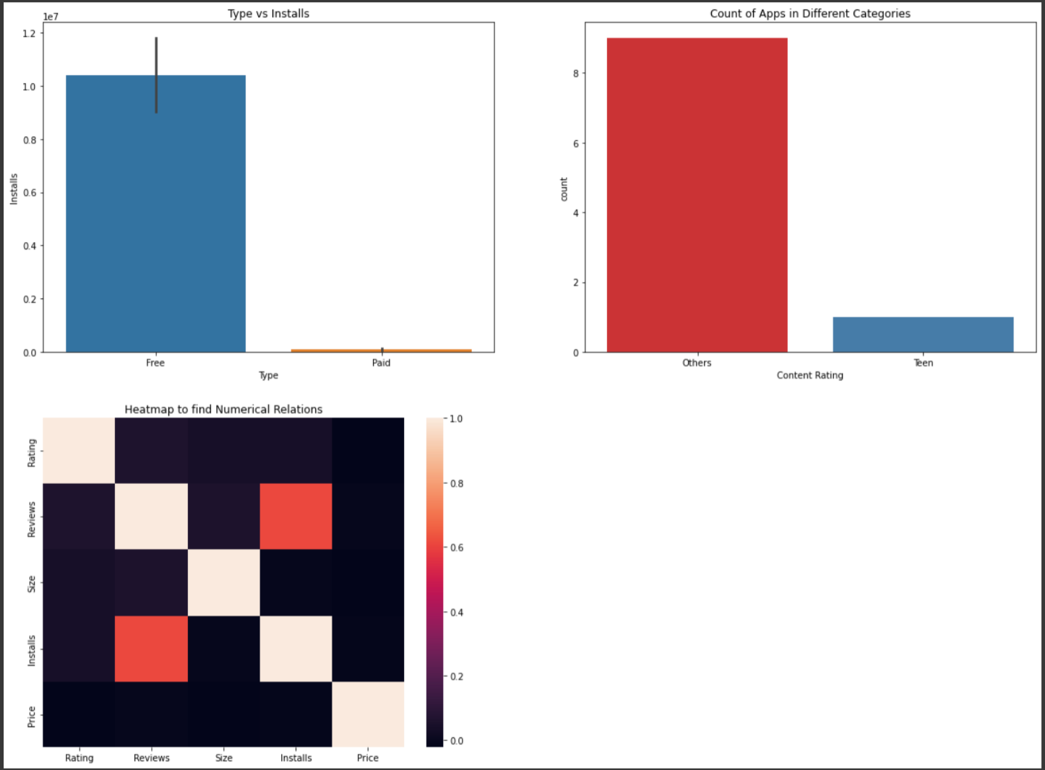
Overall Visualization with Python
Using python a barplot, countplot and a Heatmap were plotted.

Slide 25
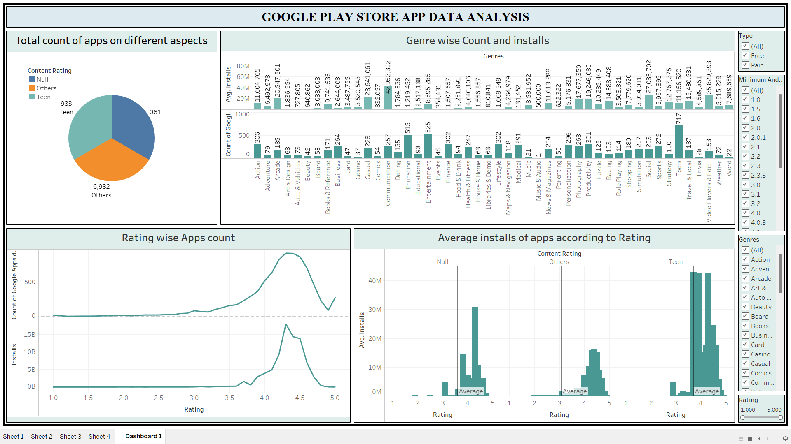
Tableau Dashboard
This Dashboard gives the basic info about the data we have.
Here a Pie-Chart and Bargraphs were generated.
By observing the above dashboard we can conclude that there are approx. 48 genres but communication holds the highest no. of installs among them.

Slide 26
LINKS TO COLAB FILE AND TABLEAU DASHBOARD
Link to google colab file :
https://colab.research.google.com/drive/1kKiHG9XXUGAmqfsWOff-HGP2YKGKNrJO?usp=sharing
Link to Tableau Dashboard :
https://public.tableau.com/views/Googleplaystoreappdataanalysis/Dashboard1?:language=en-US&publish=yes&:display_count=n&:origin=viz_share_link

Slide 27


